Slide 1
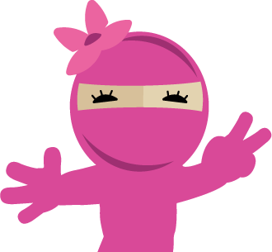



Introducing Scratch & Game Design
1.2 Explore

Slide 2
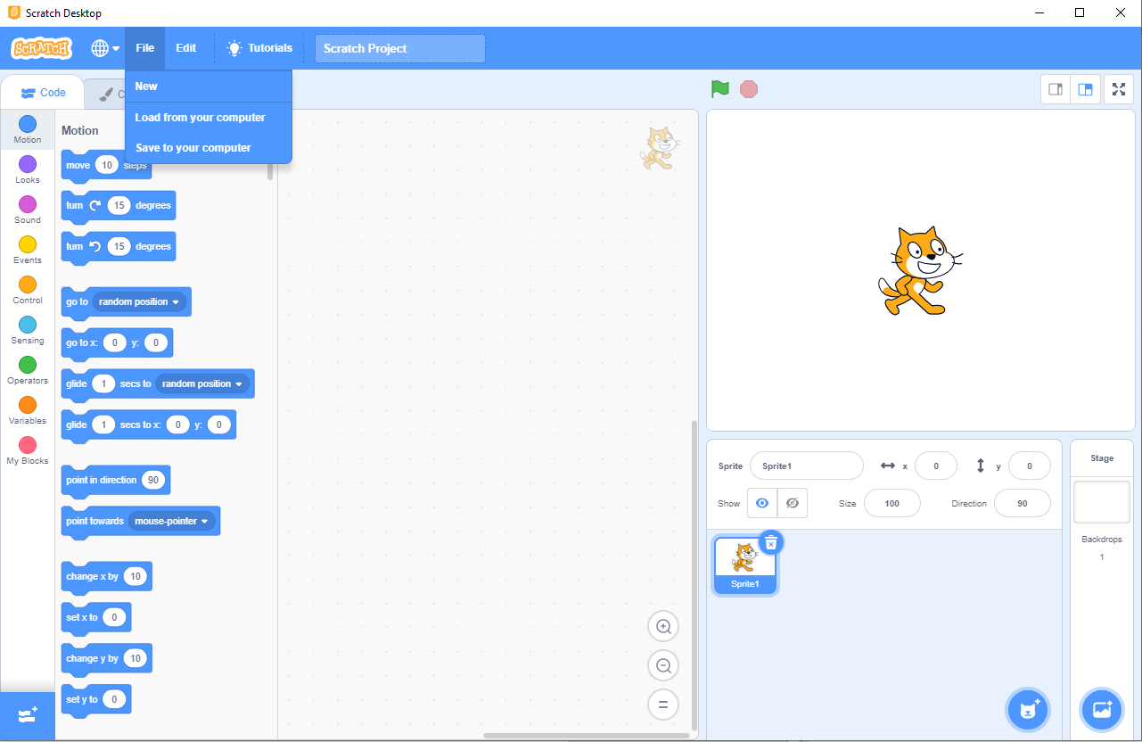
Use the file menu to save or load files

Slide 3
Drag and drop the blocks here and snap them together to create your code
Coding Aria

Slide 4
Code blocks in the Block Pallet are sorted into colored groups. Click a category to scroll to the blocks in the category

Slide 5
Start and Stop – Click the green flag to start your code, or stop sign to stop

Slide 6
Stage
Stage – Your code will run here

Slide 7
All the sprites in your project are shown here. The selected sprite has a blue border around it
Sprite List

Slide 8
Backdrop – Add new background to your project

Slide 9
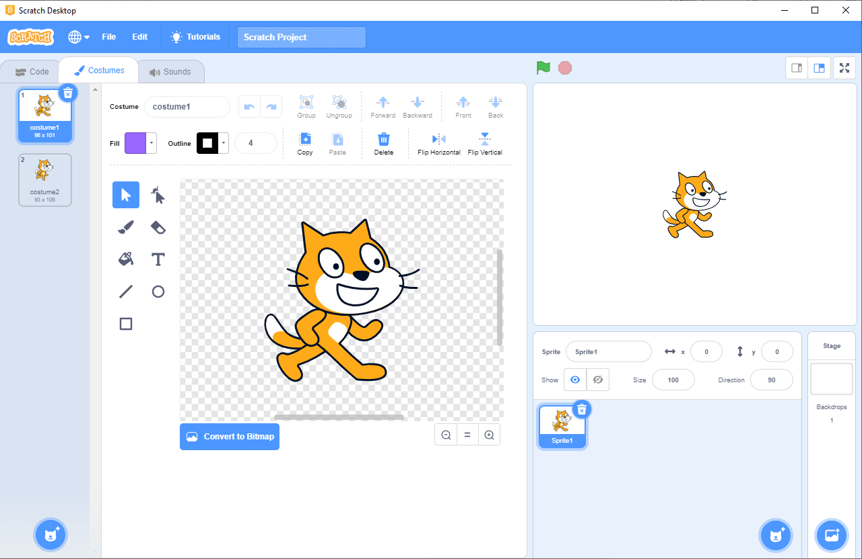
Drawing Tool - You could use this to draw on your sprite

Slide 10
Costumes – Sprite could have more than one look. Scratch calls these looks costumes. We will use different costumes to make simple animations

Slide 11
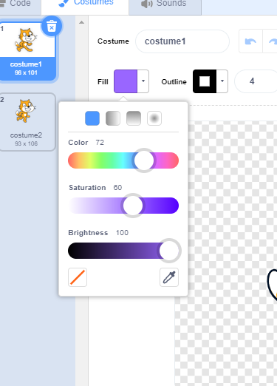
Color Sliders – We could make colors here

Slide 12
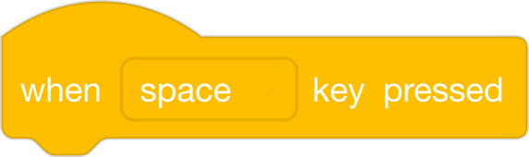
Input Block
an input is an action that tells a computer to do something. You can use input blocks to make code run when the player does something, like pressing a key or moving the mouse

Slide 13

Motion Block
this makes a sprite move

Slide 14
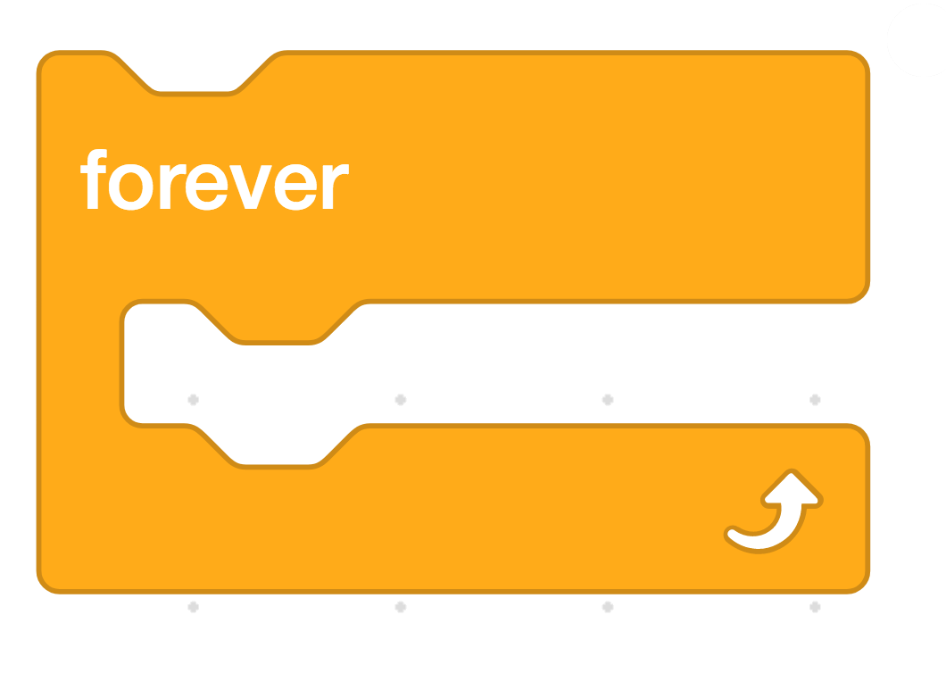
Forever Block
Any code you put inside this will keep running forever

Slide 15

Next Costume Block
This tells a sprite to change the costume, making it look like it moves

Slide 16

Wait until block
this block tells what to do if something happens

Slide 17
THE BEST GAMES IN SCRATCH
https://scratch.mit.edu/studios/26995/projects/

